Slide 1
Get-Zine to Know You
Workshop Facilitation Slides
Notes:
Welcome to Get-zine to Know You!

Slide 2

Introduction
What is a zine?
Zine
/zēn/
noun
informal
a magazine, especially a fanzine.
a webzine.
What are the 16 Personalities?
Myers-Briggs Personality Test:
Analysts
Diplomats
Sentinels
Explorers

Slide 3
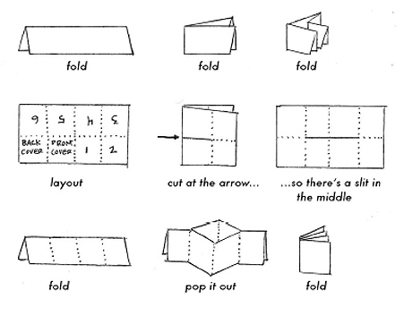
Create Your Zine!

Slide 4
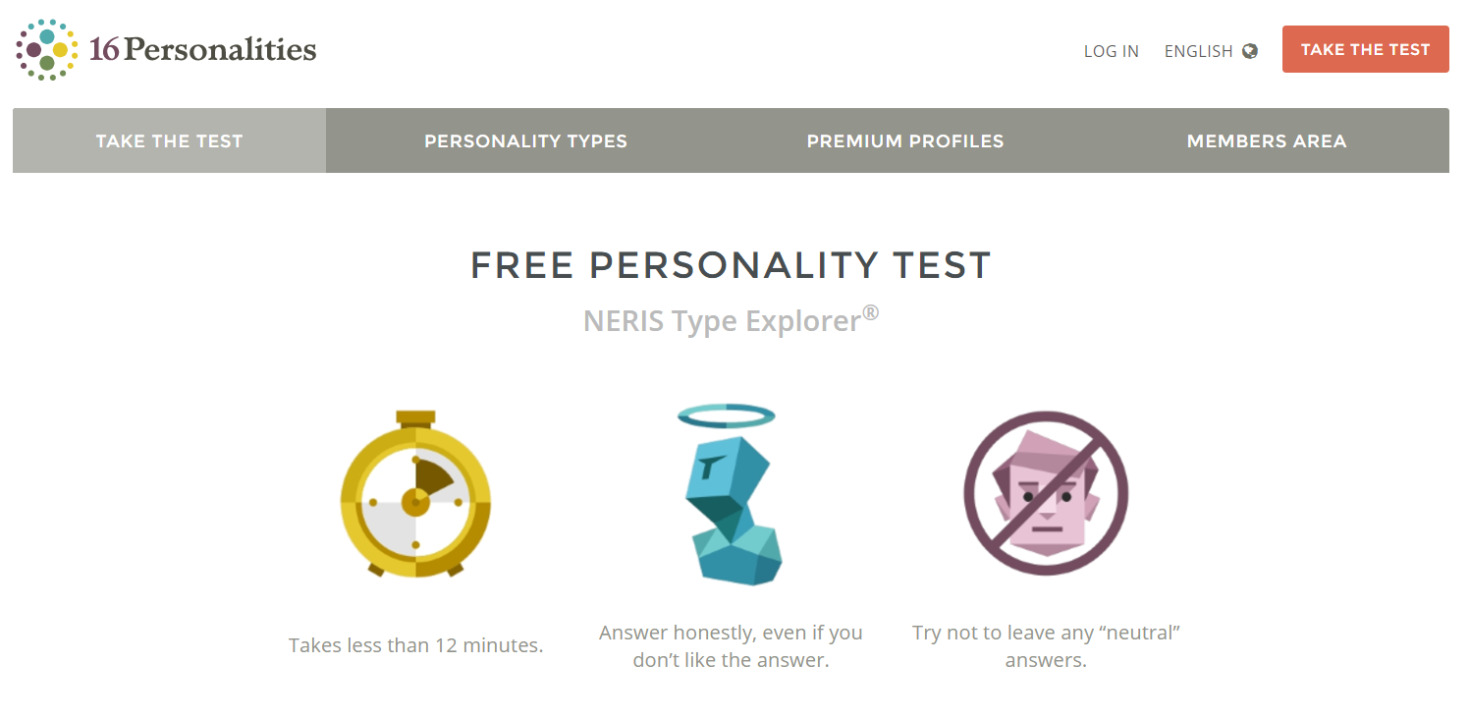
Take the Test!
https://www.16personalities.com/free-personality-test

Slide 5
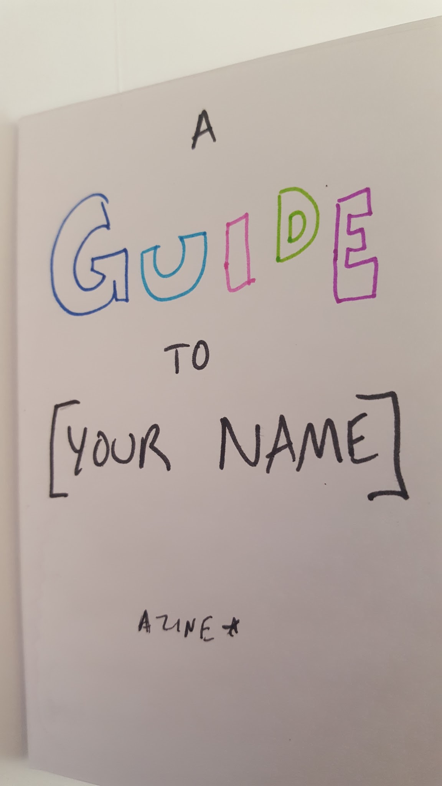
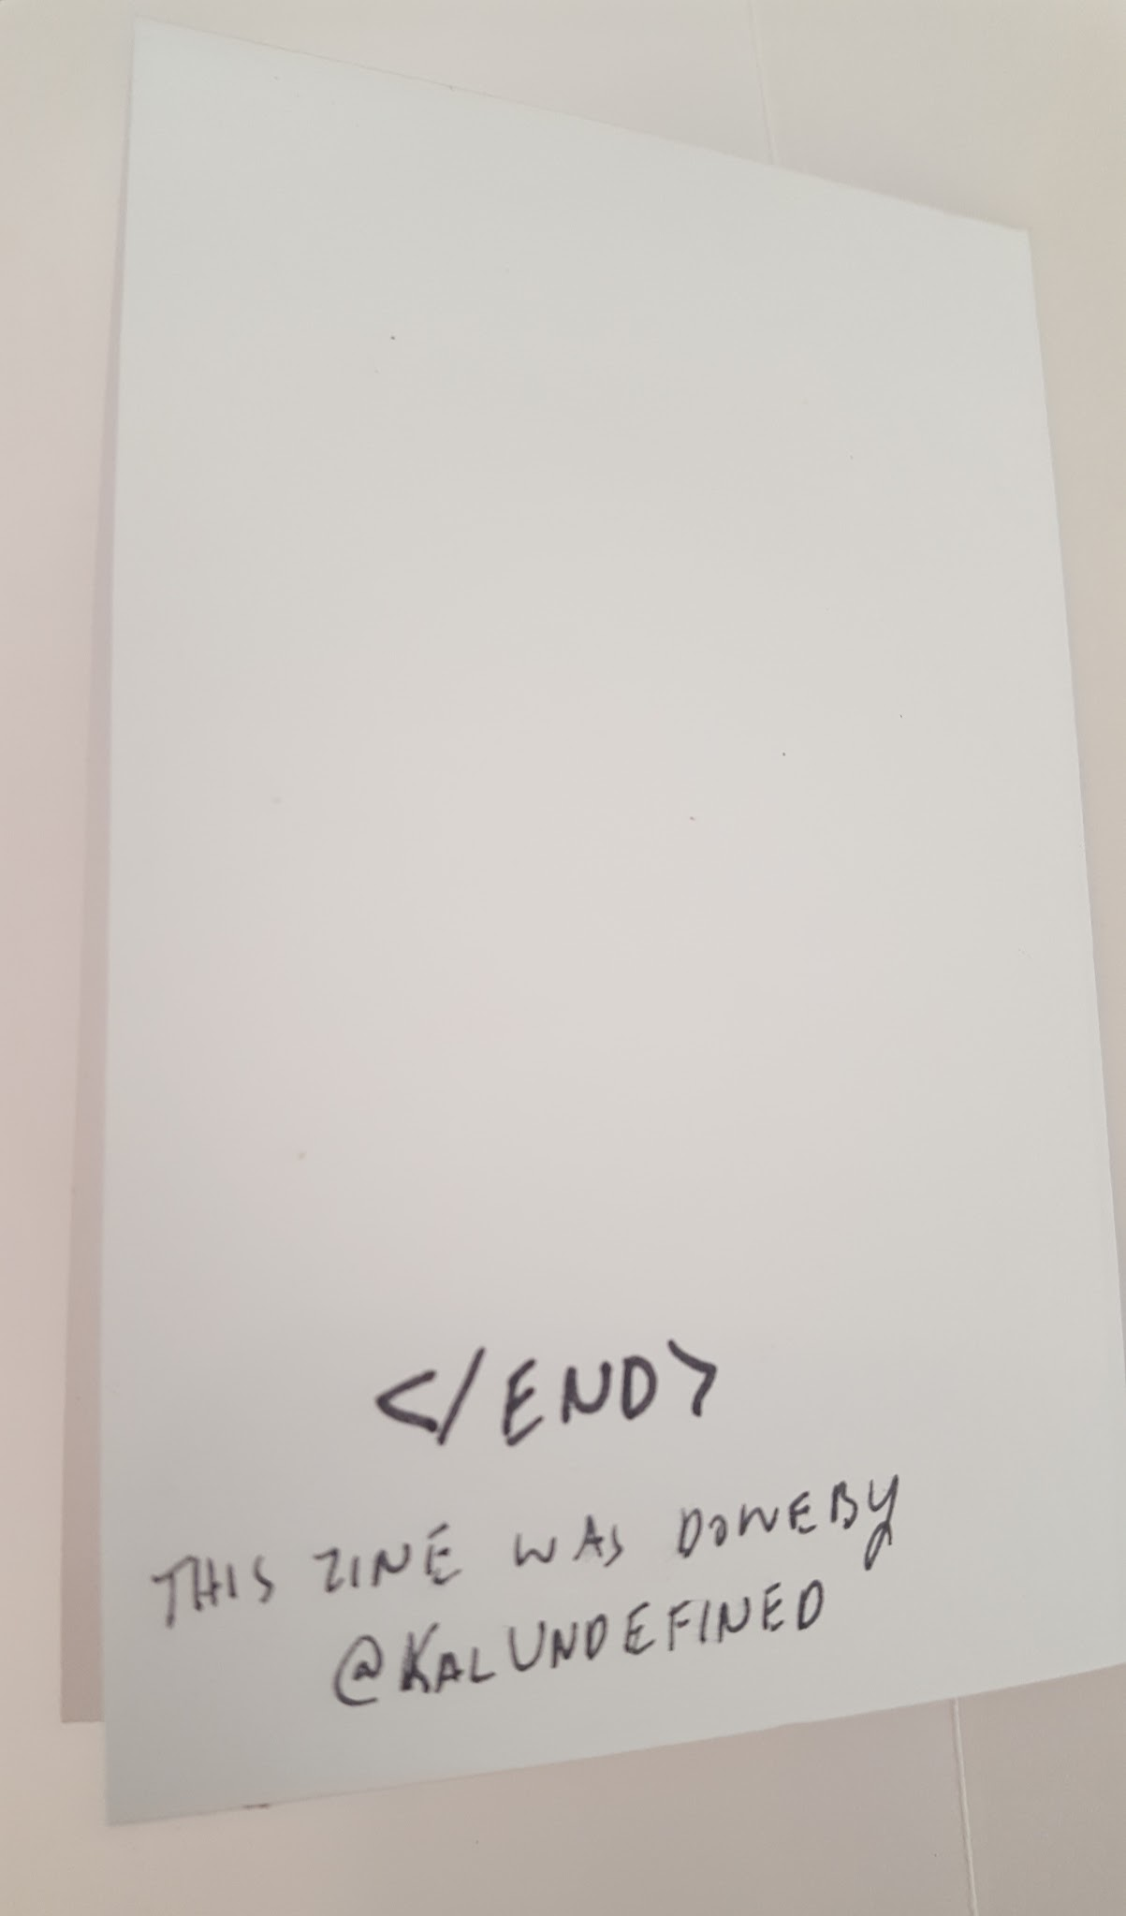
Beginning and the End

Slide 6
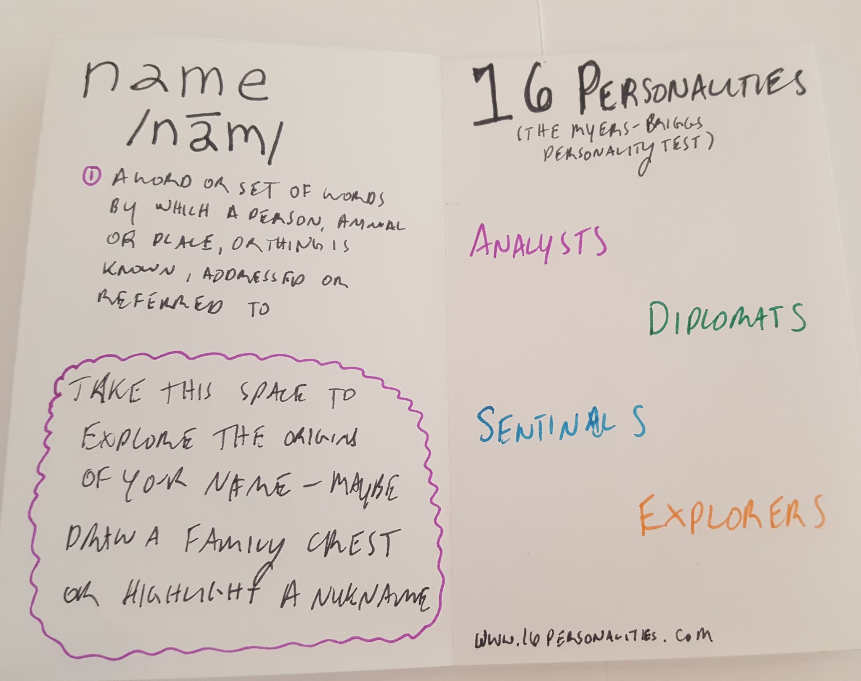
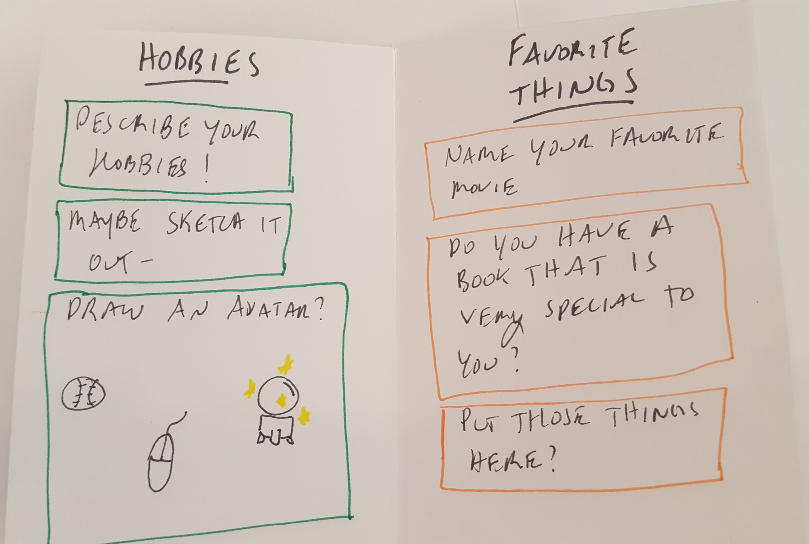
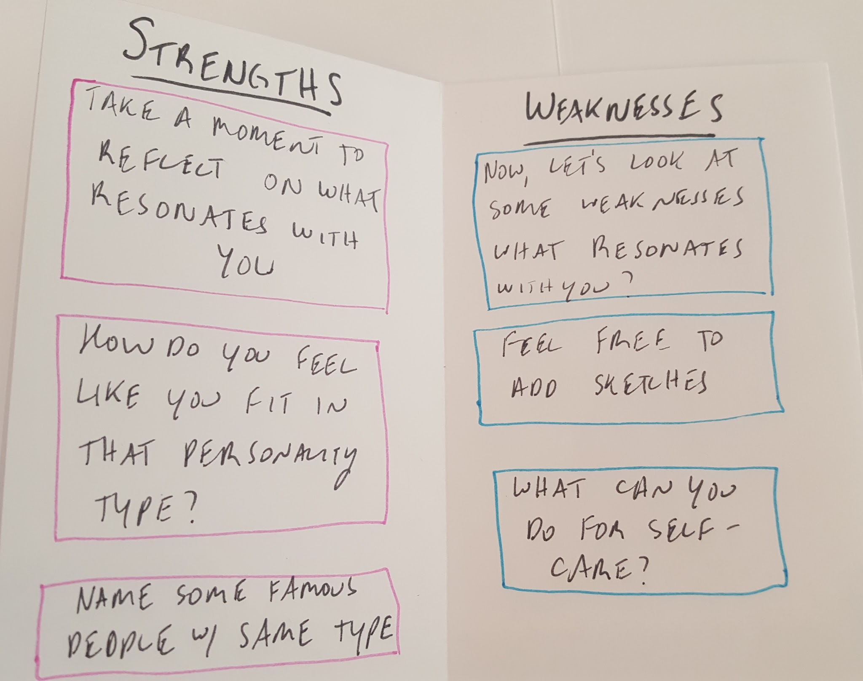
Fill it Out!

Slide 7
Suggested Format
Coverpage
Name
Personality Types
Strengths (and Famous People)
Weaknesses
Hobbies
Favorite Things
End Page

Slide 8
Discussion!
What did you like?
What did you learn?
What could be improved upon?
What can you do to be better to your coworkers?

Slide 9
Thank you!

Slide 10
References
https://www.16personalities.com/free-personality-test
https://github.com/kamxhmartin/getzinetoknowyou

